Slide 1
ECE 532 DATA STRUCTURES AND ALGORITHMS
CHAPTER 1: REVISION OF COMPUTER PROGRAMMING CONCEPT
(ARRAY 1-D)
Lecturer: Dr. Roslina Mohamad
Room: Tower 2, Level 13, No:14C
Contact No: 03-55436068

Slide 2

Before We Begin…
Recite Du’a

Slide 3

At the end of this lecture, you will be able to:
Revise about arrays
Understand how to declare and manipulate data into arrays

Slide 4
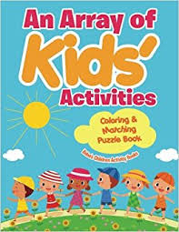

Slide 5
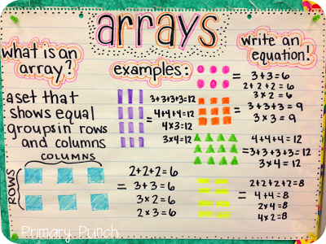
Arrays
Array: a collection of a fixed number of components wherein all of the components have the same data type
Array: variable that can store multiple values of the same type
In a one-dimensional array, the components are arranged in a list form

Slide 6

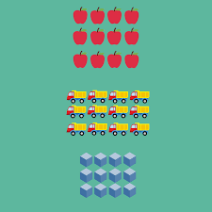

Slide 7

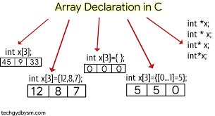
Declaration of 1-D Array
Syntax for declaring a one-dimensional array:
where intExp, called an index/subscript, is any expression whose value is a positive integer
Index value specifies the position of the component in the array
[] is the array subscripting operator
The array index always starts at 0

Slide 8
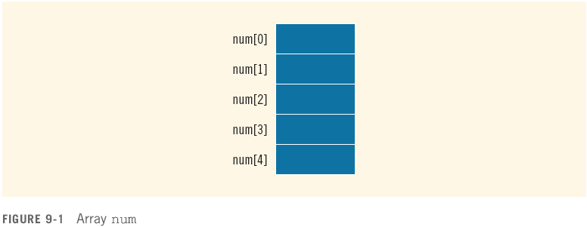
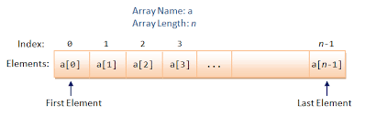
Arrays
Example:
int num[5];

Slide 9

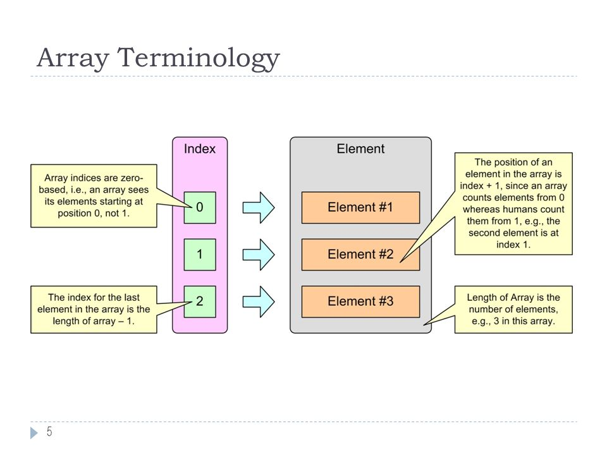
Array Terminology
In the definition
int tests[ISIZE];
int is the data type of the array elements
tests is the name of the array
ISIZE, in [ISIZE], is the size declarator. It shows the number of elements in the array.
The size of an array is the number of bytes allocated for it
(number of elements) * (bytes needed for each element)

Slide 10
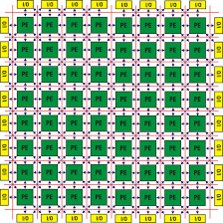
Processing One-Dimensional Arrays
Some basic operations performed on a one-dimensional array are:
Initializing
Inputting data
Outputting data stored in an array
Finding the largest and/or smallest element
Each operation requires ability to step through the elements of the array
Easily accomplished by a loop

Slide 11
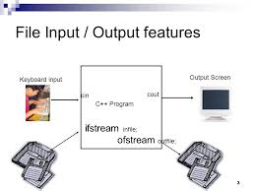
Inputting and Displaying Array Contents
cout and cin can be used to display values from and store values into an array
const int ISIZE = 5;
int tests[ISIZE]; // Define 5-elt. array
cout << "Enter first test score ";
cin >> tests[0];
//See Example 1.6

Slide 12
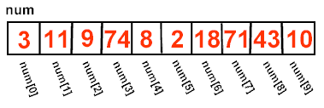
Array Subscripts
Array subscript can be an integer constant, integer variable, or integer expression
Examples: Subscript is
cin >> tests[3]; int constant
cout << tests[i]; int variable
cout << tests[i+j]; int expression

Slide 13
Processing One-Dimensional Arrays
Consider the declaration
int list[100]; //array of size 100
int i;
Using for loops to access array elements:
for (i = 0; i < 100; i++) //Line 1
//process list[i] //Line 2
Example:
for (i = 0; i < 100; i++) //Line 1
cin >> list[i]; //Line 2

Slide 14
Accessing All Array Elements
To access each element of an array
Use a loop
Let the loop control variable be the array subscript
A different array element will be referenced each time through the loop
for (i = 0; i < 5; i++)
cout << tests[i] << endl;
// See Example 1.7

Slide 15

Processing One-Dimensional Arrays

Slide 16
Array Initialization
Can be initialized during program execution with assignment statements
tests[0] = 79;
tests[1] = 82; // etc.
Can be initialized at array definition with an initialization list
const int ISIZE = 5;
int tests[ISIZE] = {79,82,91,77,84};
Notes:
See pr8-05.cpp, pr8-06.cpp, and pr8-07.cpp

Slide 17
Example of Array Initialization Using Assignment Statement
See Example 1.8

Slide 18

Array Initialization During Declaration
Arrays can be initialized during declaration
In this case, it is not necessary to specify the size of the array
Size determined by the number of initial values in the braces
Example:
double sales[] = {12.25, 32.50, 16.90, 23, 45.68};

Slide 19
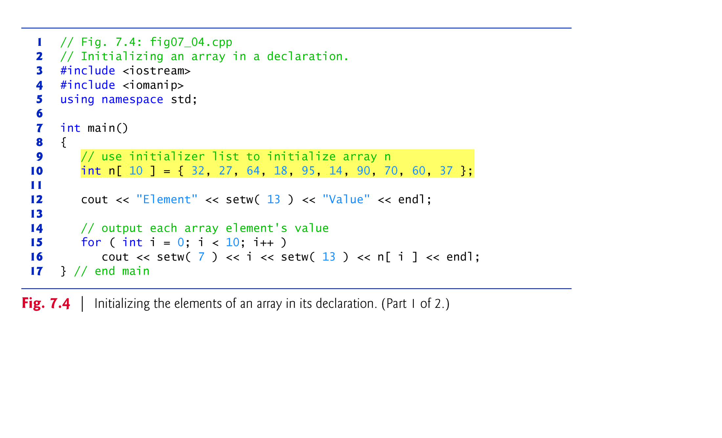

Slide 20
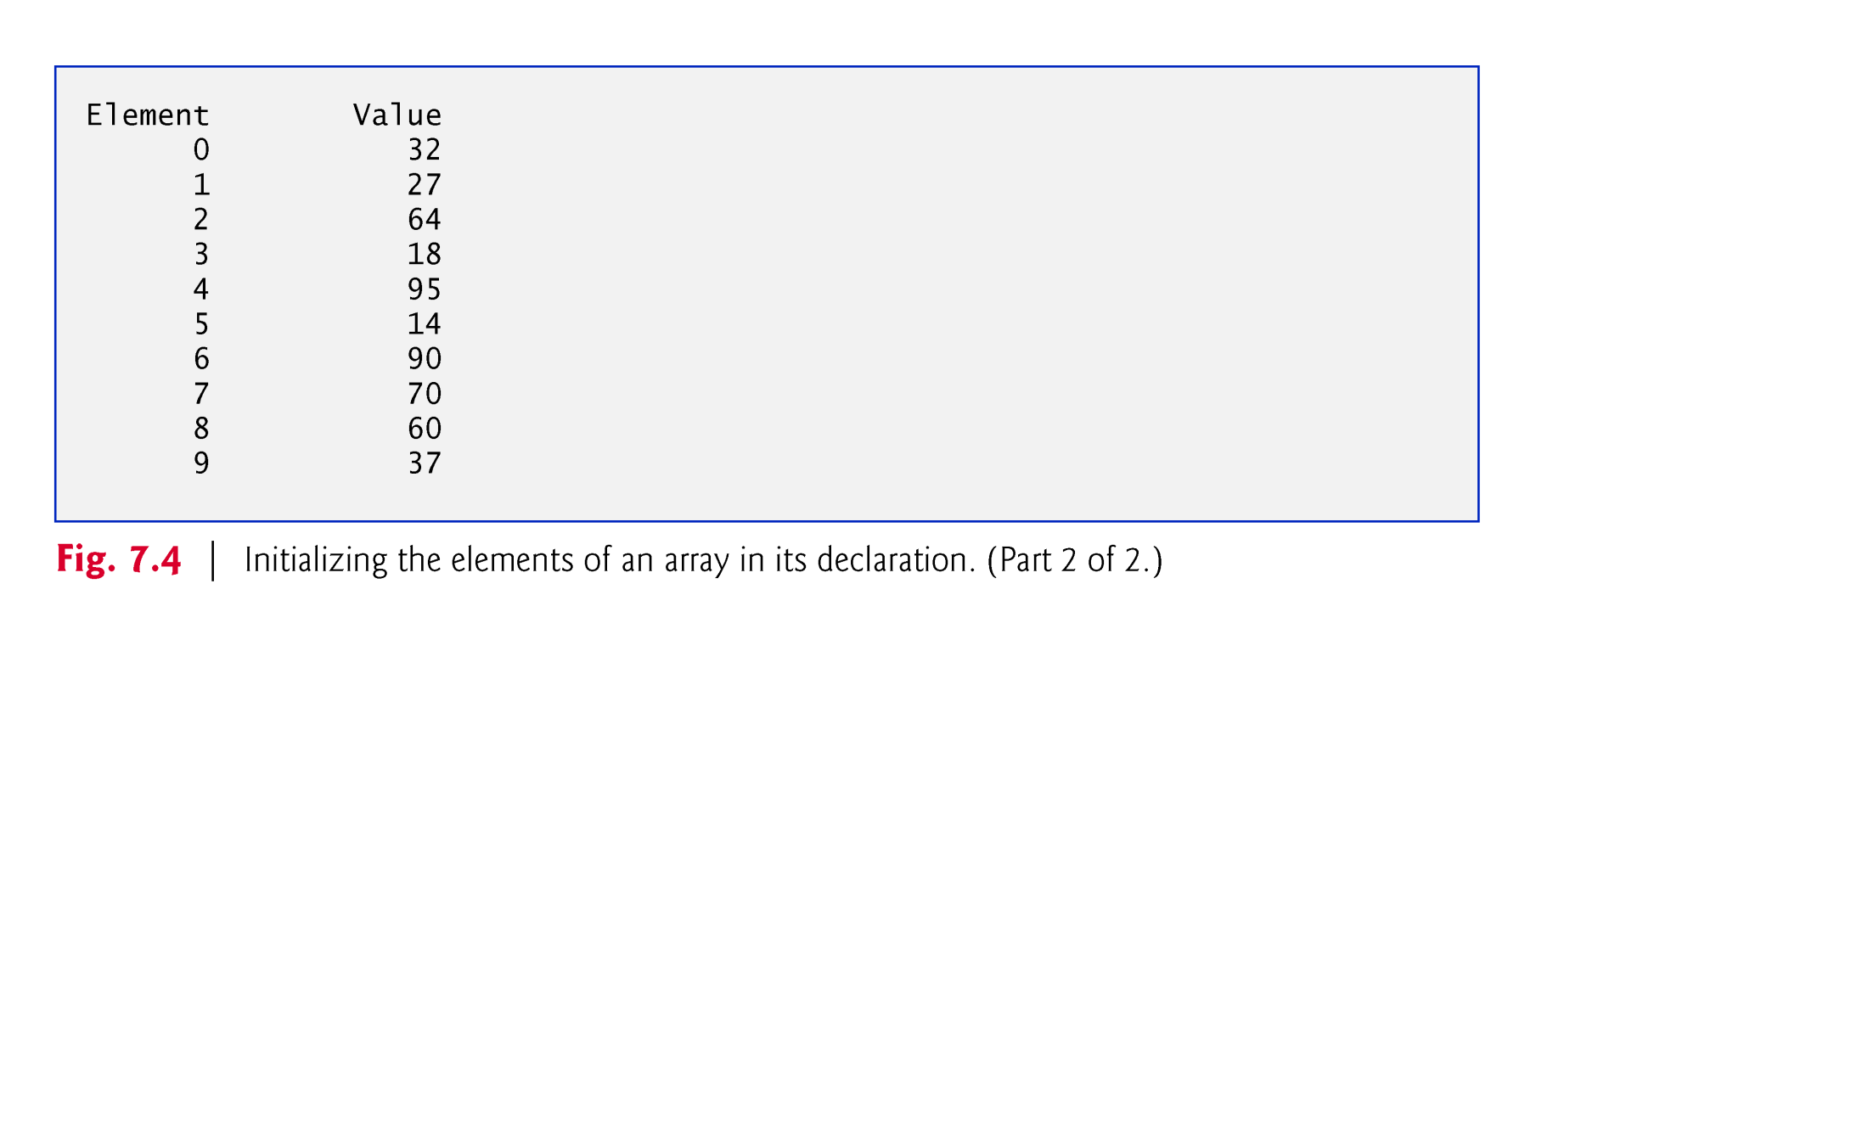

Slide 21
Example of Array Initialization using Initialization List
//See Example 1.9,
Example 1.10,
Example 1.11

Slide 22
Partial Array Initialization
If array is initialized at definition with fewer values than the size declarator of the array, remaining elements will be set to 0 or the empty string
int tests[ISIZE] = {79, 82};
Initial values used in order; cannot skip over elements to initialize noncontiguous range
Cannot have more values in initialization list than the declared size of the array
See Example 1.12
79 | 82 | 0 | 0 | 0

Slide 23
Partial Initialization of Arrays During Declaration
The statement:
int list[10] = {0};
declares list to be an array of 10 components and initializes all of them to zero
The statement:
int list[10] = {8, 5, 12};
declares list to be an array of 10 components, initializes list[0] to 8, list[1] to 5, list[2] to 12 and all other components are initialized to 0

Slide 24
Partial Initialization of Arrays During Declaration
The statement:
int list[] = {5, 6, 3};
declares list to be an array of 3 components and initializes list[0] to 5, list[1] to 6, and list[2] to 3
The statement:
int list[25]= {4, 7};
declares an array of 25 components; initializes list[0] to 4 and list[1] to 7; all other components are initialized to 0
// See Example 1.12

Slide 25
Processing One-Dimensional Arrays

Slide 26
Processing Array Contents
Array elements can be
treated as ordinary variables of the same type as the array
used in arithmetic operations, in relational expressions, etc.
Example:
if (principalAmt[3] >= 10000)
interest = principalAmt[3] * intRate1;
else
interest = principalAmt[3] * intRate2;
//See Example 1.13
Notes:
See pr8-09.cpp

Slide 27
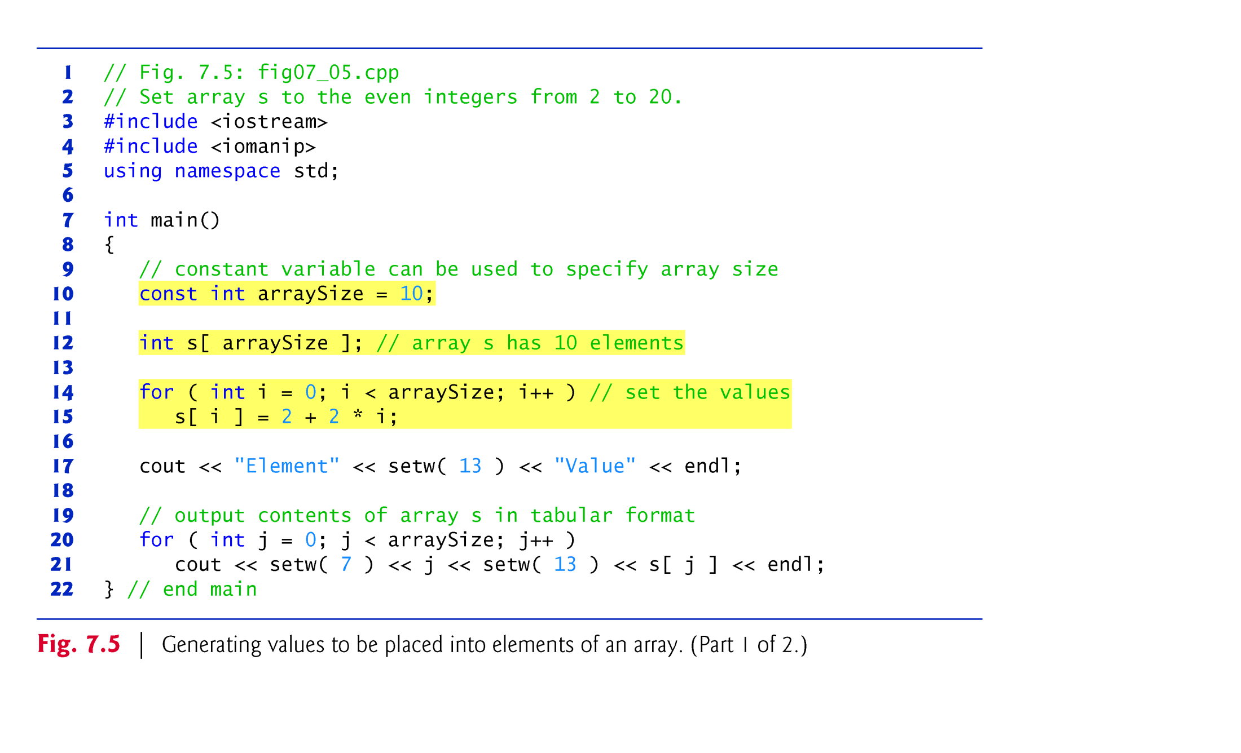

Slide 28
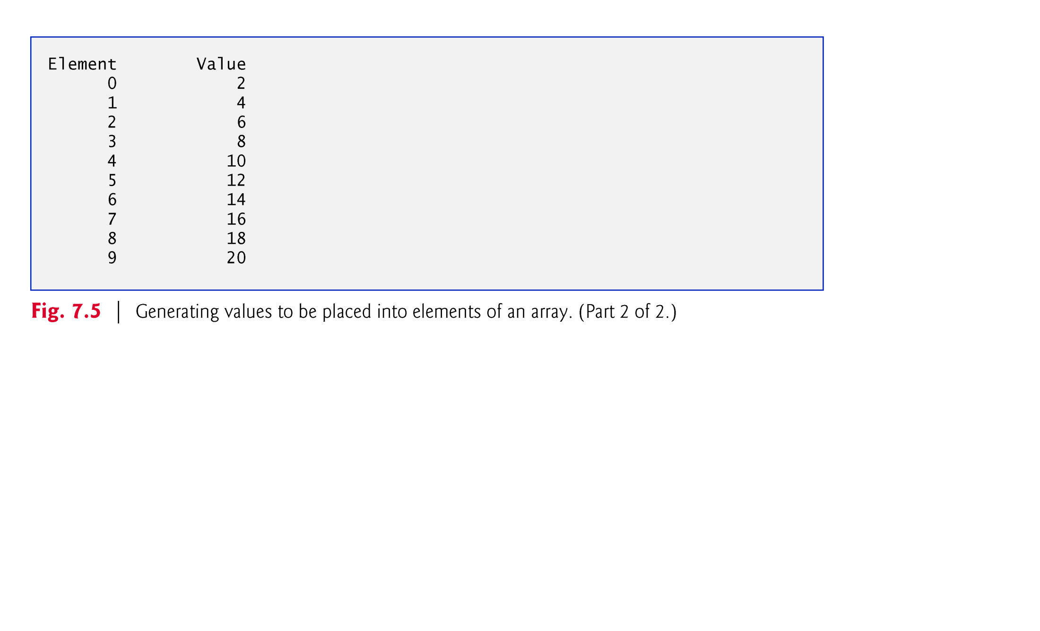

Slide 29
Dynamic Memory Allocation
Can also use new to allocate array
arrayPtr = new double[25];
Program may terminate if there is not sufficient memory
Can then use [ ] or pointer arithmetic to access array

Slide 30

Releasing Dynamic Memory
Use delete [] to free dynamic array memory
delete [] arrayptr;
Only use delete with dynamic memory!
Notes:
See pr10-14.cpp

Slide 31
Dynamic Memory Example
int *arrayptr;
int count=5;
arrayptr = new int[count];
for (int i=0; i<count; i++)
{
cout << "Enter score " << i << ": ";
cin >> arrayptr[i];
}
delete [] arrayptr;
arrayptr=NULL;

Slide 32
